Slide 1

Minor Project
( C O M – 7 1 1 )
Final Evaluation
Team Members:
Gautam Kumar (2021A1R005)
Sachit Sharma (2021A1R027)
Reetikesh Bali (2021A1R037)
Mehul Kalra (2021A1R023)
Project Idea:
PLANT LEAF DISEASE DETECTION USING DEEP LEARNING
PRESENTED TO – ASST. PROF. PALLAVI SHARMA
D E P A R T M E N T OF C O M P U T E R S C I E N C E A N D E N G I N E E R I N G M I E T ( A U T O N O M O U S ), J A M M U

Slide 2

PROBLEM STATEMENT
Agriculture's Global Importance: Agriculture forms the backbone of global food economy, with plant health being critical to sustaining crop yields and feeding the growing population.
Impact of Plant Diseases: Causes significant loss in crop production annually. It also leads to food scarcity, economic downturns for farmers, and increased reliance on imports in affected regions.
Challenge with Traditional Methods: Manual disease detection is labour-intensive, time-consuming, and prone to human error. It requires expert knowledge, which may not be accessible in rural or underdeveloped regions.

Slide 3
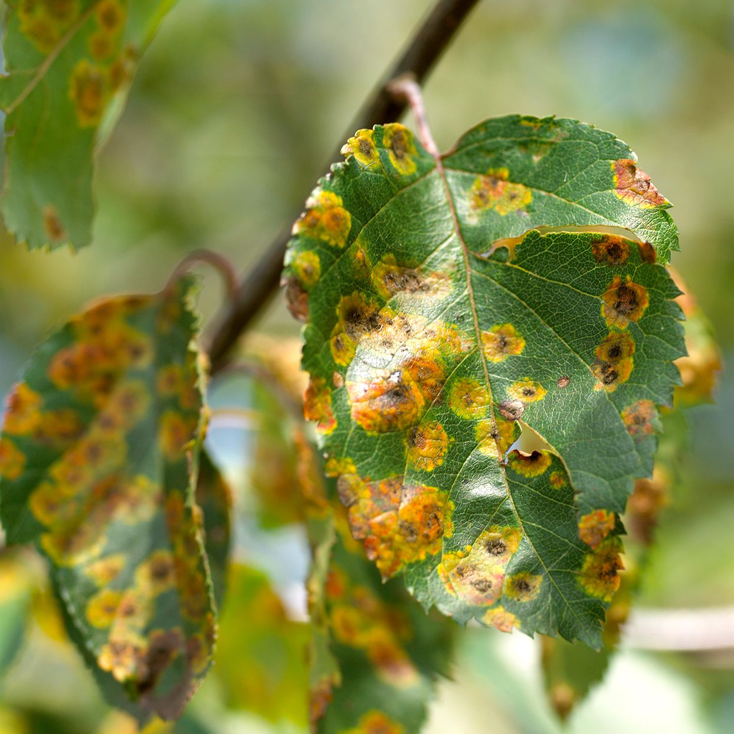
INTRODUCTION
This project is a leaf disease detection system that uses deep learning techniques, including transfer learning, to identify and classify 38 different types of leaf diseases.
The model has been trained on a large dataset of images and is designed to help agricultural professionals and enthusiasts diagnose plant diseases in a fast and accurate manner.

Slide 4
KEY FEATURES
Convolutional Neural Network (CNN) Implementation: Developed using TensorFlow to classify leaf images into 38 distinct categories.
Dataset Utilization: Trained on the Plant Village dataset, which provides a comprehensive collection of labelled leaf images.
Self-Developed Training Model: Offers a trained model for immediate use.
Demo Images Test: Contains sample images to demonstrate the model's prediction capabilities.
Accuracy: Our system utilizes state-of-the-art machine learning techniques for accurate disease detection.

Slide 5
TECHNOLOGIES USED
TensorFlow : An open-source machine learning framework used for training and building the deep learning model.
NumPy : A powerful library for numerical computing in Python, used for efficient array operations and data manipulation.
Streamlit : simplifies creating interactive Python apps for data visualization, machine learning, and real-time analysis.
Python : The primary programming language used for building the model and the web application.

Slide 6
DEMONSTRATION

Slide 7
THANK YOU

